Slide 1
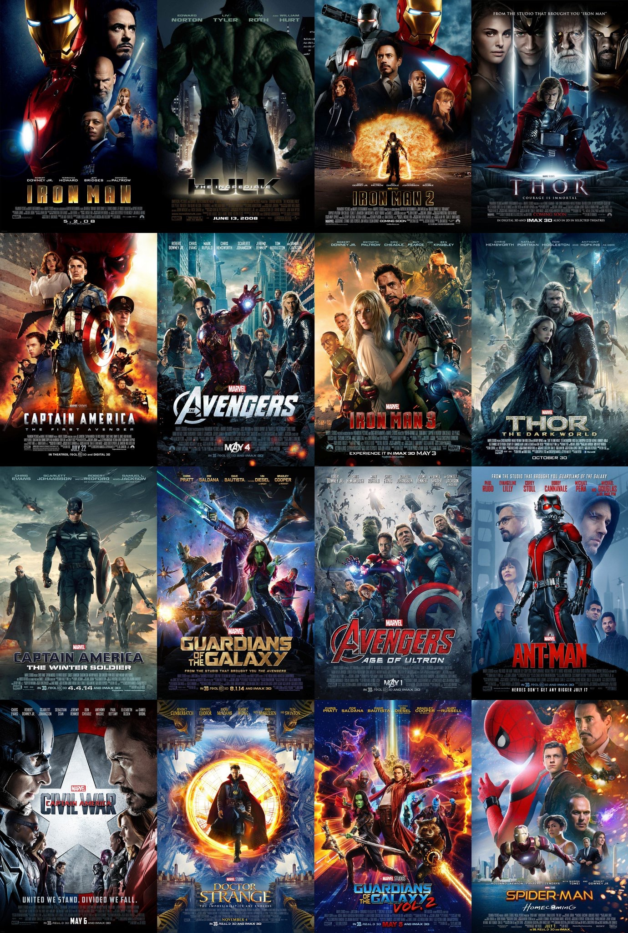
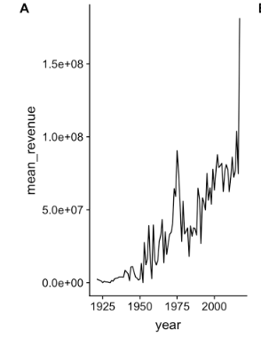

TMDB Box Office Prediction
Team: Yuting Gong, Cijun Sun, Mianchun Lu, Miller Luo
Notes:
Last year, the movie industry achieved a huge success, and its total revenue nearly got to $12 billion. However, what kind of movies make the most money? How much does the crews matter? Or the budget? Or the runtime? This is the topic we’d like to discuss today.

Slide 2
Content
Prediction
Exploratory Data Analysis
Conclusion & Recommendation
Raw Data
train dataset: 3000 rows
test dataset: 4398 rows
variables: 23
Modeling
FeatureEngineering
Notes:
In this project, we studied more than 7,000 past films, and applied EDA and predictive analysis. We hope our project can help the production companies enhance their movies’ revenue.

Slide 3
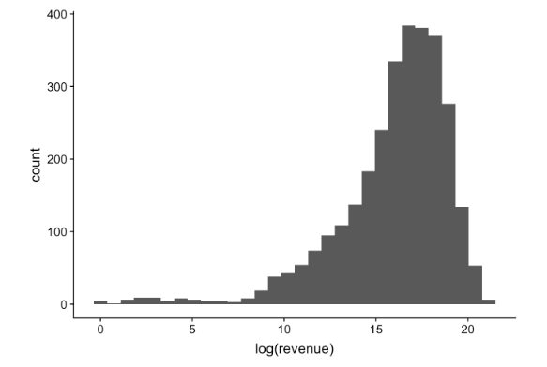
EDA and Feature Engeering
Variable type | Variable name
numeric | Budget, popularity, runtime, revenue
categorical | original_language, production_countries, spoken_languages, status
JSON format | Genres, production_companies, belongs_to_collection, cast, crew,
text | Original_title, tagline, title, keywords, overview
date | release_date
dependent variable
(transfer to log)
"[{'id': 35, 'name': 'Comedy'}]"
"[{'id': 35, 'name': 'Comedy'}, {'id': 18, 'name': 'Drama'}, {'id': 10751, 'name': 'Family'}, {'id': 10749, 'name': 'Romance'}]" "[{'id': 18, 'name': 'Drama'}]"
“A live-action adaptation of Disney's version of the classic 'Beauty and the Beast' tale of a cursed prince and a beautiful young woman who helps him break the spell.”
Drop
"2/20/15" "8/6/04" "10/10/14" "3/9/12"
Notes:
Revenue is the dependent variable, but its distribution has a VERY high skewness! So we transformed it with log. In our independent variables, apart from numeric, categorical variables, we also have text and date. And some of variables are in the JSON format.
Let’s look at these variable types one by one.

Slide 4
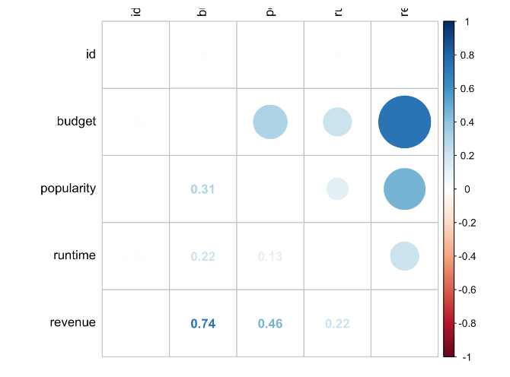
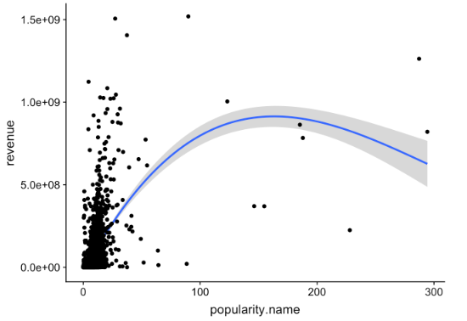
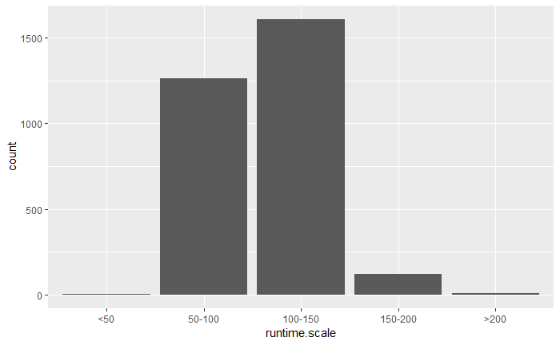
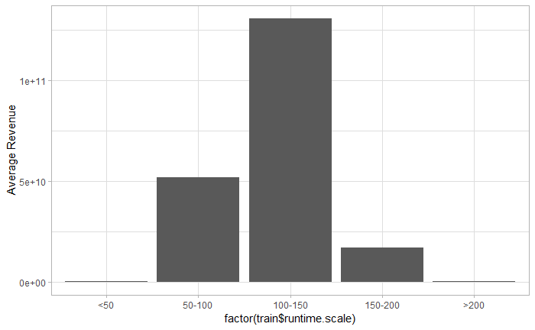
Variable: Numeric
Budget has the highest positive correlation with revenue. And popularity is the second one.
Runtime:
0--50 min
50--100 min
100--150 min
150--200 min
200+ min
Movies with runtime between 100 minutes and 150 minutes have the highest average revenue.
Notes:
For the numeric variables, budget has the highest positive correlation with revenue. And popularity is the second one.

Slide 5
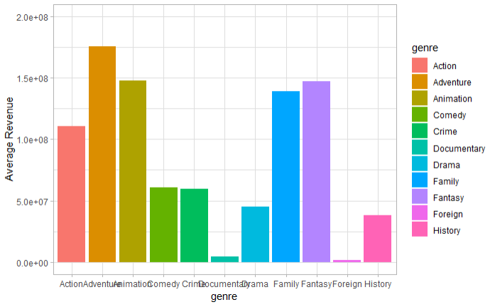
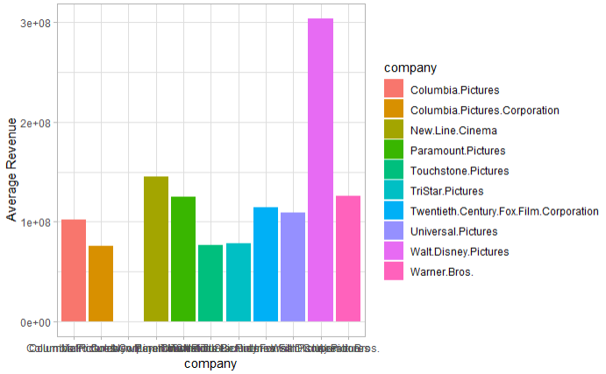
Variable: JSON
Genre:
Producing Company:
Adventure
Family, Fantacy
Animation
Walt Disney
The most common types:
Drama, Comedy, Thriller, and Action
The types with higher average revenue:
Adventure, Animation, Family, and Fantasy
Companies produced more movies:
Warner Bros, Universal Pictures, and Paramount Pictures
Company having the highest revenue:
Walt Disney
Notes:
Then, about how to deal with the variables in JSON format. We counted all the unique types appeared in one column, and created several dummy variables to show if a movie belongs to a certain type. For genres, Adventure movie made really high revenue. And for producing companies, Disney is a true industry leader.

Slide 6
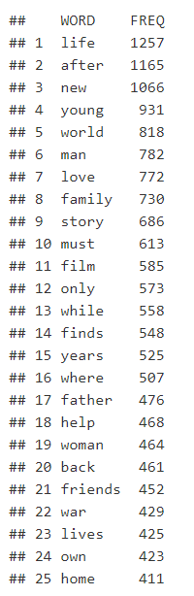
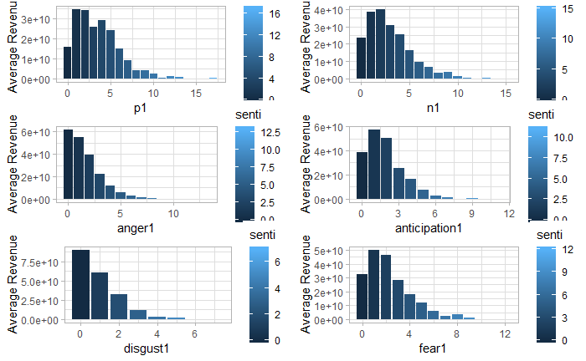
Variable: text
Movies with high revenue tend to include limited number of sentimental words.
The emotion of their overview is relatively neutral.
Notes:
Then, the text part. We used “nrc” and “afinn” lexicon to do the sentiment analysis on the movie overview. And a conclusion can be got that movies with high revenue tend to include limited sentimental words. The emotion of their overview is relatively neutral.

Slide 7
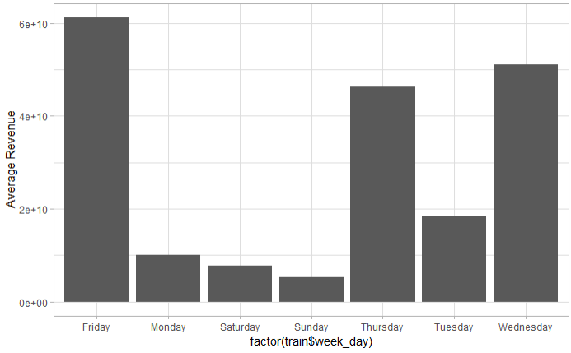
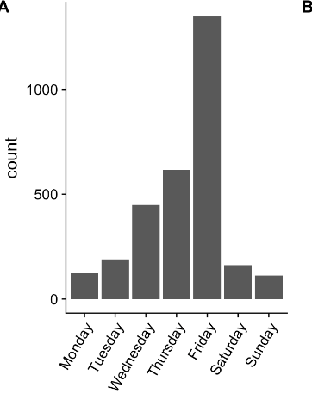
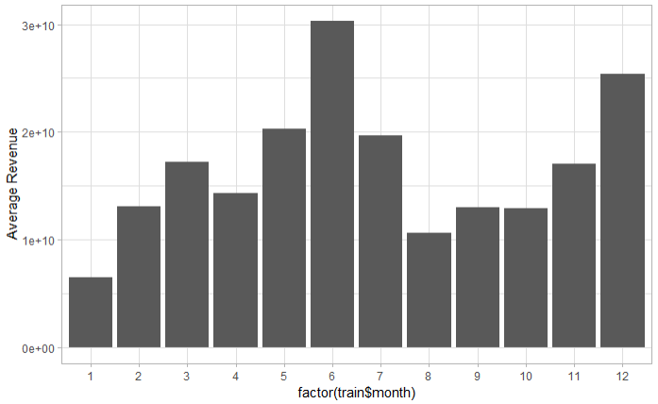
Variable: Date
Feature
Engeering
"2/20/15"
Release Date
Year
Month
Day
Week Day
Notes:
The last part of our feature engineering is to deal with the release date. Movies released in June and December tend to have higher revenue. I think this maybe because those high-budget movie would choose to be on in vacation.

Slide 8
PART II. Model Fitting
XGBOOST
CLUSTERING THEN PREDICT
70%
65%
75%
DEEP LEARNING
100%
RANDOM FOREST
SVM
Notes:
After adding some tdidf and sentiment features from text mining, we started to fit varioud models. Some of the model we tried including xgboost, clustering then predict, deep learnign, random forest and svm. Due to limited presentation time, we will focus talking about few of them.

Slide 9
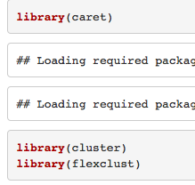
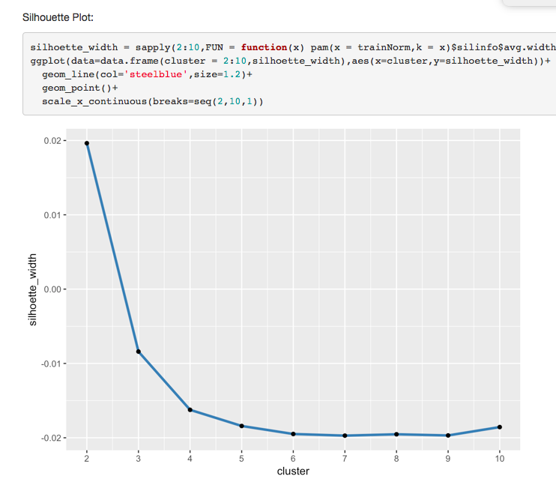
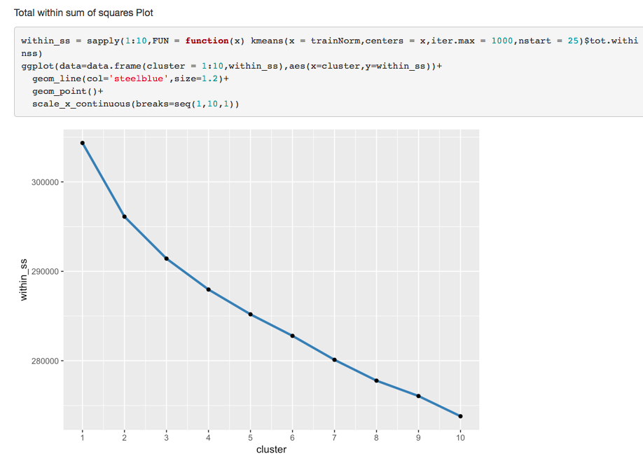
Model Experimentation - Clustering then predict + xgboost
Learning
Process:
Clustering does not work for our movie data set
Dummy works
Data preparation: dummyVars to dummy,and choose fullRank=T to avoid linear dependencies between the columns
K-means clustering
A k= 2 clusters are suggested by both Total Within Sum of squares plot and Silhouette width plot
Built two xgboost models based on clusters and combine
Package and functions we used:
Total Within Sum of Squares
Silhoette Width
Model | Kaggle RMSLE
Clustering then predict | 2.23
No clustering | 2.19
Notes:
The first one we would like to share is clutering then predict based on xgboost. As we see in class that cluster then predict could help improve model accuracy. We wanted to test it out. To process categorical data for clustering and xgboost, we used a dummyvars function from caret package. To avoide linear dependencies, we used fullRank =True to delete one dummy column to achieve number of columns one less than the factor levels. For the clustering, we decied to adopt k-means clutering and used total within sum of squares and silhoette width to help decided optimal cluster number. A number of 2 are recommended by both plots. As a result, we get the below rmsle error measure. Surprisely, the clustering method does not work well. XGboost without clustering actually achieve lower rmsle! We reflected on the sitation and got two possibilities why it doesn’t work weel. First, maybe movies are more comlicated than 2 cluters. However, if we split data into more clusters, we won’t have enough train data to train the model well. As a result, we decided to use xgboost without clustering and keep the dummy method.

Slide 10
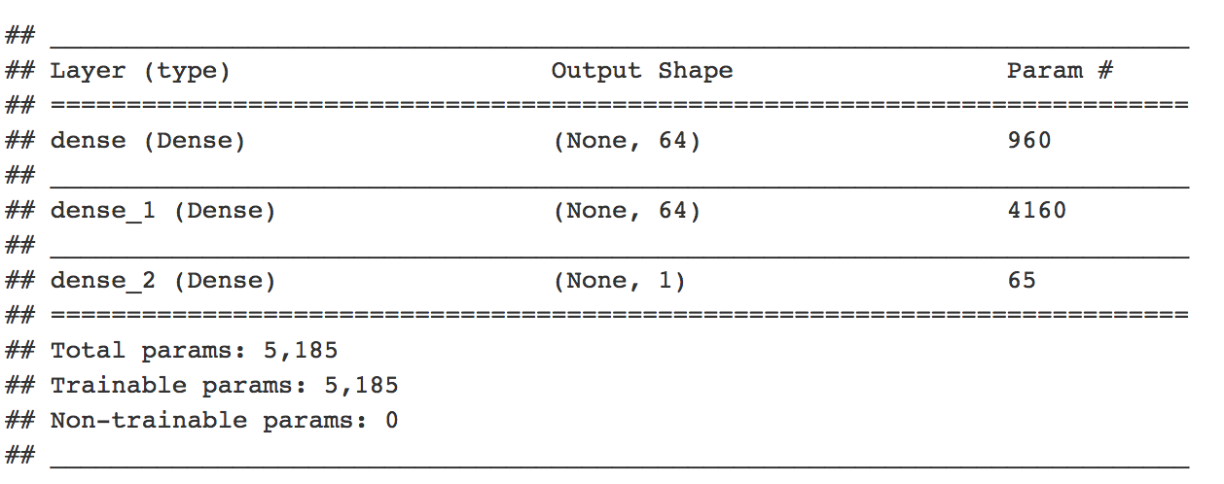
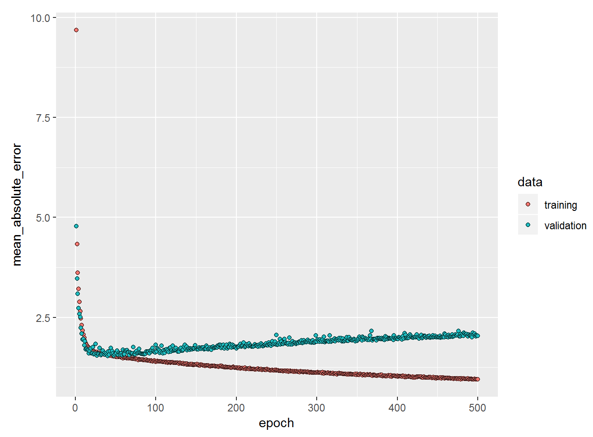
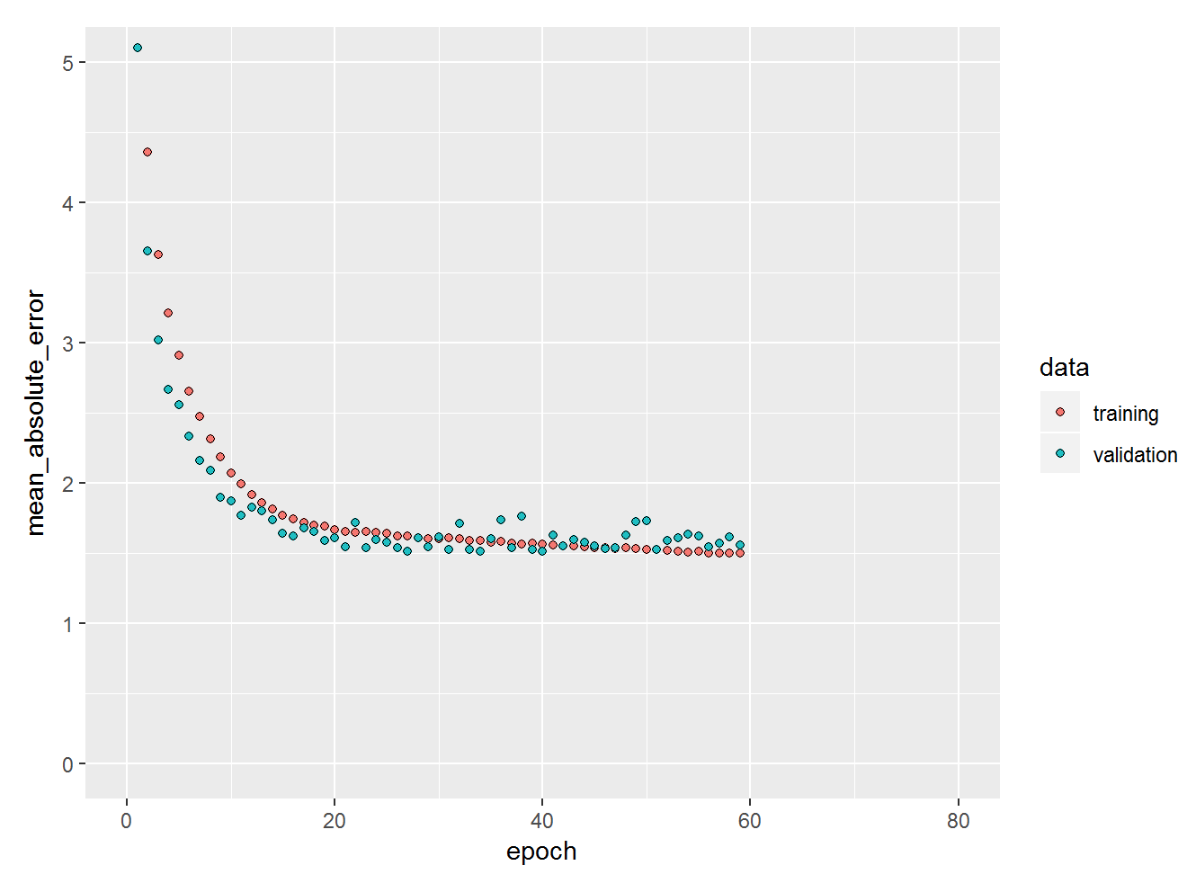
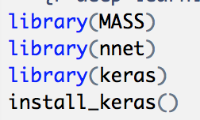
Model Experimentation - Deep learning
Process:
Learning
I tried two different library “nnet” and “keras”.
The library nnet contains a basic neural network function, nnet()
Keras: Normalization + a sequential model
Neural nets are not good models for sparse data.
How to transform your data to make it something more neural net compatible.
Keras provides more hidder layers which gives better performance,
Package and functions we used:

Slide 11
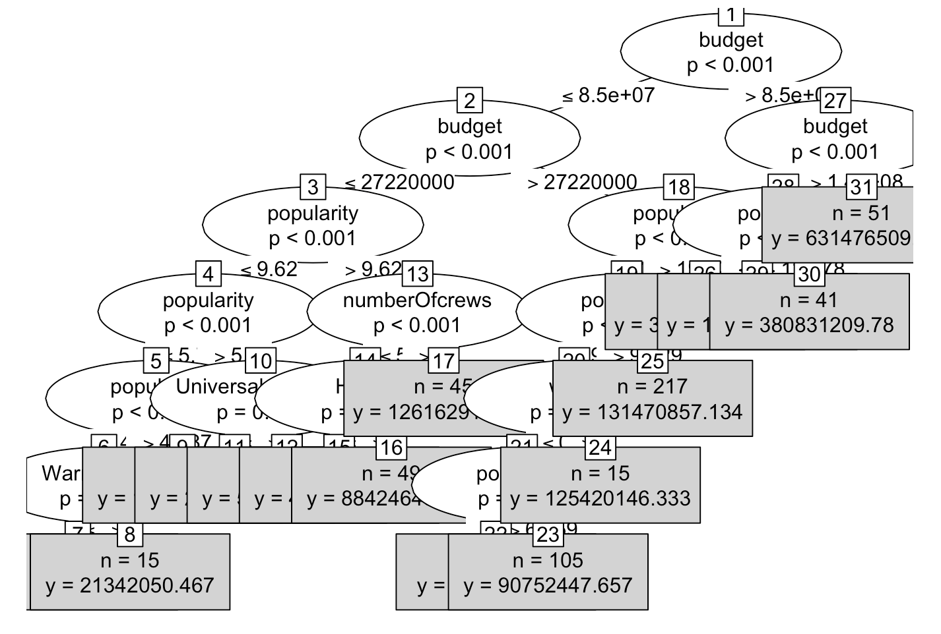
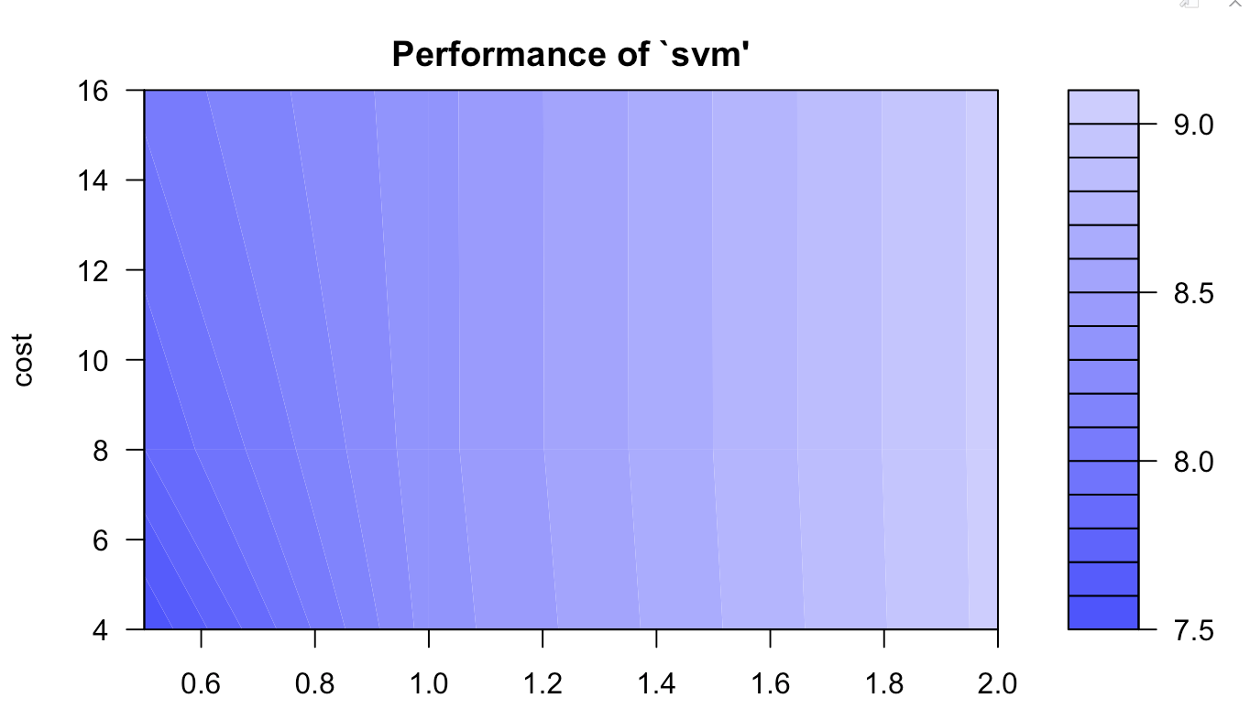
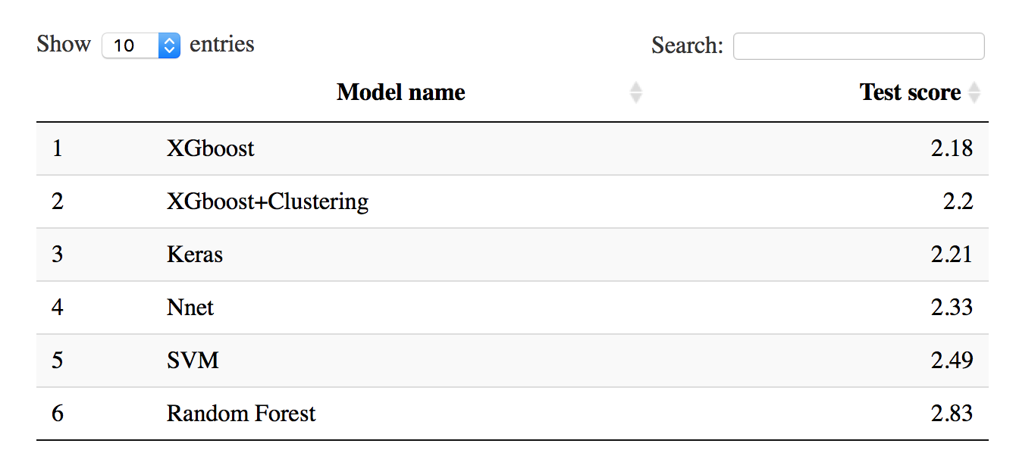
Model Experimentation - SVM and RandomForest
Process:
SVM: the data points lie in between the two borders of the margin which is maximized under suitable conditions to avoid outlier inclusion;
cost = 1000
gamma = 1000
tune.svm()
Random Forest: Random forests has two advantages.
Firstly, reduction in over fitting: by averaging several trees
Secondly, less variance
Plot for randomforest with library(party)
Final results:
Package and functions we used:
library(rpart)
library(svm)
library(RandomForest)

Slide 12
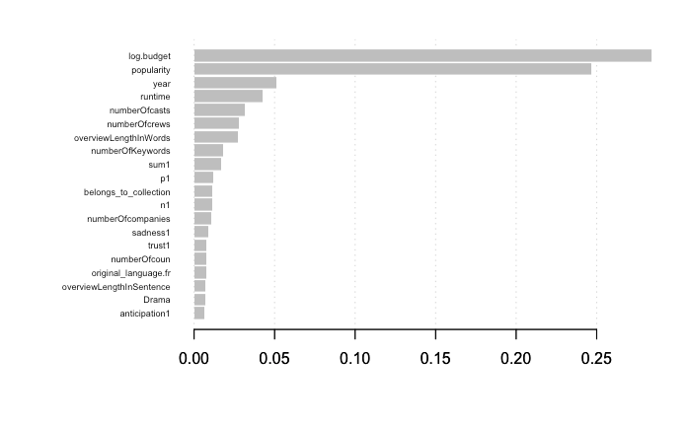
The conclusion
We ran a variable importance plot based on the xgboost model as shown on the left to understand what factors influence movie revenue.
Based on the importance plot, we concluded that: the most important variables are: budget, number of casts and number of crews, popularity. Overview Length sentiment, proper runtime, and Movies belongs to a collection.

Slide 13
Suggestiones for producers
Movie producers to write detailed overview with proper amount of positive words to attract consumers.
Movie producers with low budget to wisely allocate their resources to marketing to increase popularity and exposure among consumers before release date.
Proper runtime and belonging to a certain collections are also suggested for producers.

